Slide 1

Notes:
VO : Hello Brown, We hope you are having a great month so far.

Slide 2
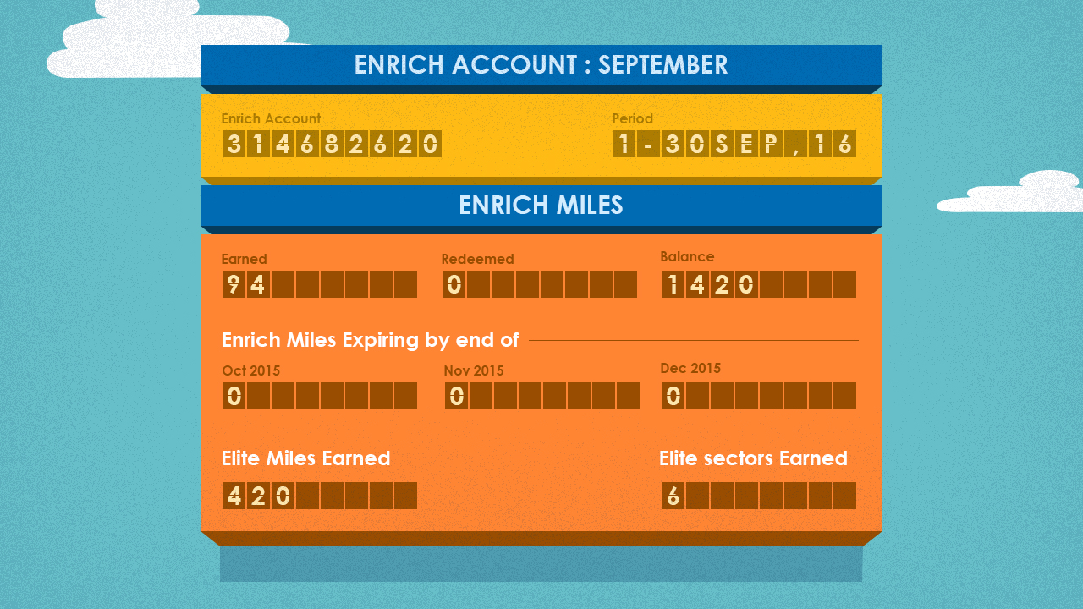
Notes:
VO : Here is your Enrich Miles statement for the month of September.

Slide 3
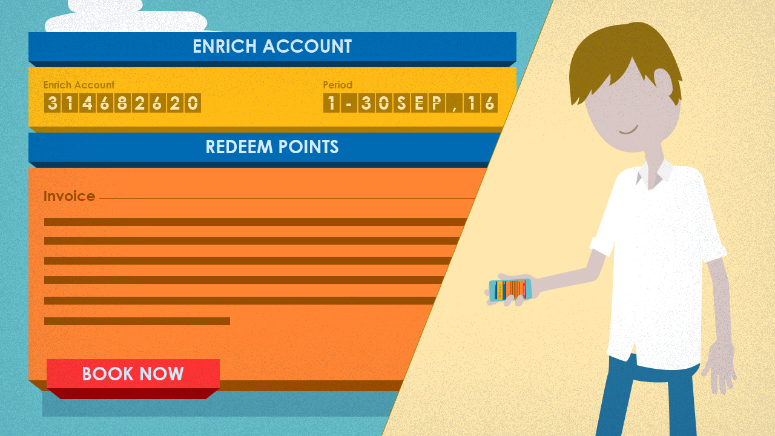
Notes:
VO : To redeem your points, visit our Enrich website to check all redemption offers and plan a exciting holidays with Enrich.

Slide 4

Notes:
VO : Visit our enrich website now to experience the new look and feel that enables you to check your account details and redemption offers with ease.

